Slide 1
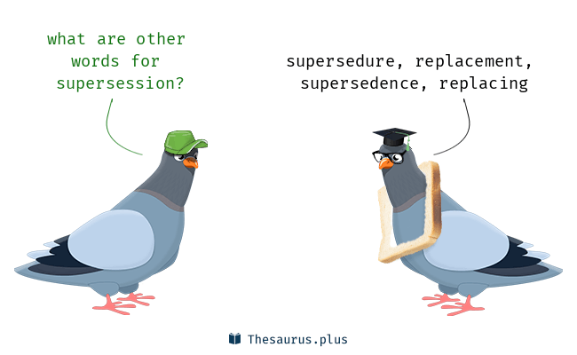
Parts Supersession

Slide 2
Supersession Business Scenarios
Single Supersession – One to One
Multiple Supersession – One to Many
Multiple Supersession – Many to One
Variable Supersession – One to Many Groups
Variable Supersession – Many Groups to One

Slide 3
Single Supersession – One to One
Single Supersession – one part is replaced by another one
Part A
Part B

Slide 4
Multiple Supersession – One to Many – Split
Multiple Supersession – one part is replaced by 2 or more parts
Part B
Part A
Part C
Part D

Slide 5
Multiple Supersession – Many to One - Merge
Multiple Supersession – 2 or more parts are replaced by 1 one part
Part A
Part B
Part D
Part C

Slide 6
Variable Supersession – One to Many Groups – Split
Variable Supersession – one part is replaced by 2 or more groups of parts. You need to make choice which group to choose
For Model Year
2010-2019
For Model Year
2019-
Part B
Part B
Part C
Part A
Part C
Part E
Part D

Slide 7
Variable Supersession – Many Groups to One – Merge
Variable Supersession – one part is replaced by 2 or more groups of parts. You need to make choice which group to choose
For Model Year
2010-2019
For Model Year
2019-
Part A
Part E
Part B
Part D
Part F
Part C
Part G

Slide 8
Supersession Chain – Consecutive Replacements
Supersession Chain – one part is replaced another, which is replace by another part...
Progressive View
Part A
Part B
Part C
Retrospective View
Part A
Part B
Part C

Slide 9
Complex Supersession Chains
Excavators
Part B
Wheel Loaders
Part A
Part C
Part E
Part D
Part F
Part G

